Slide 1
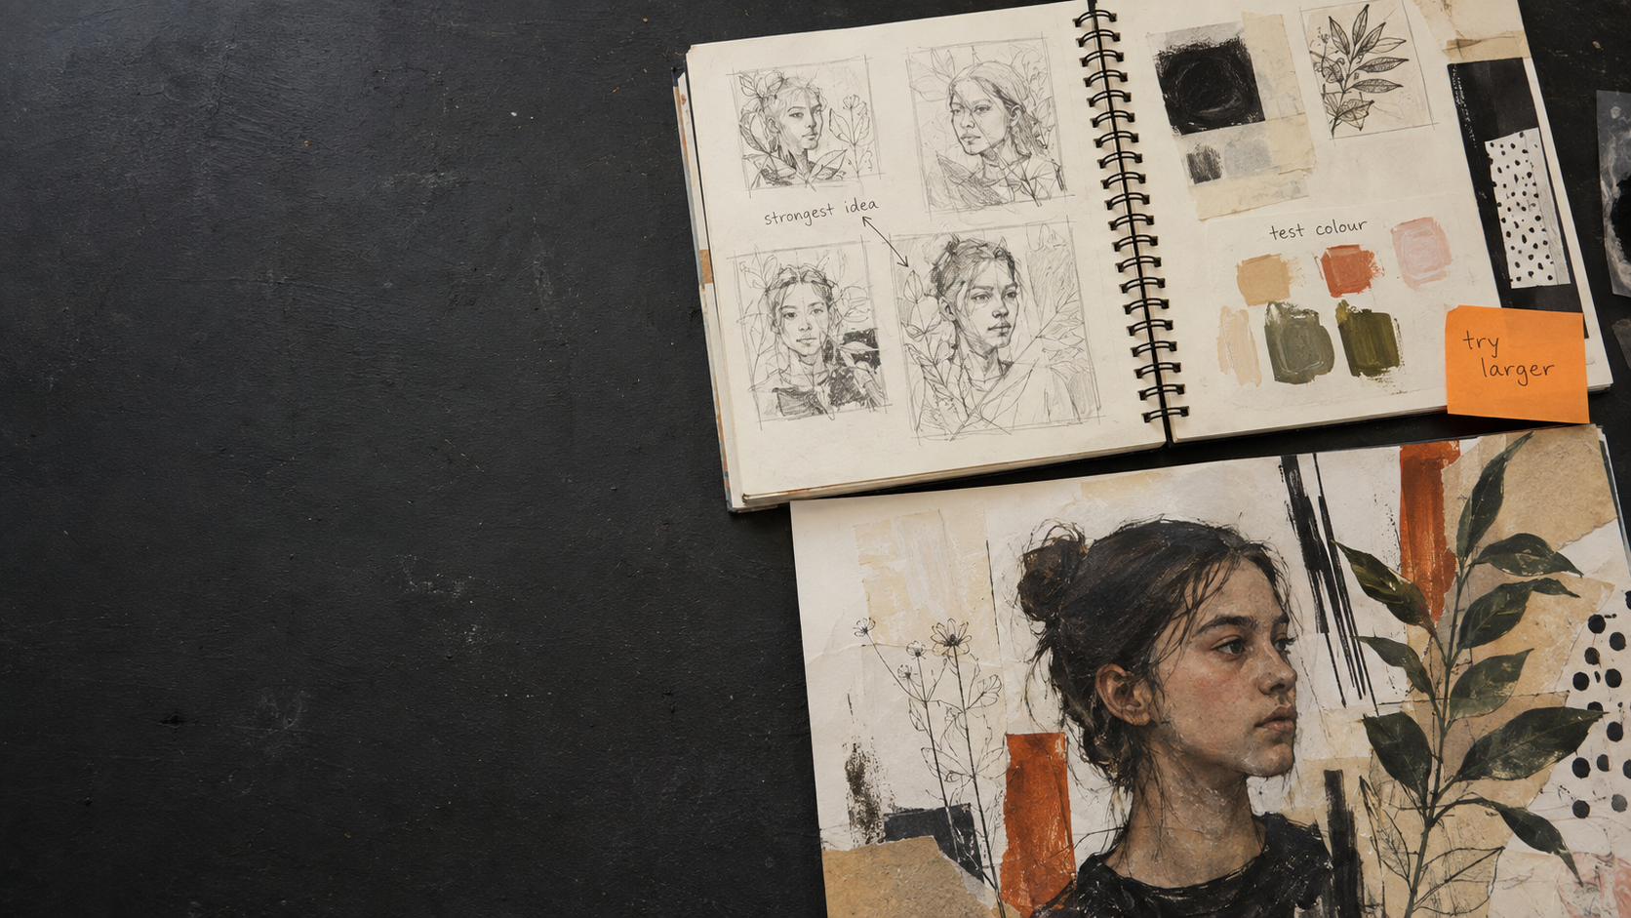
FINAL OUTCOME
Planning a Successful
Final Outcome
Turning development into a
purposeful final piece
PORTFOLIO TO A STAR
Notes:
Introduce the final outcome as the result of a visible creative journey. Explain that a successful piece grows from investigation, experiments, review and refinement rather than appearing as an unrelated last-minute idea.
[Sources]
- Original Portfolio to A Star teaching material.
- Original AI-generated student-art image created for this resource.

Slide 2
A final outcome grows from the journey
IDEA
→
TEST
→
REFINE
The final piece should not arrive from nowhere.
PORTFOLIO TO A STAR • TEACHER RESOURCE
02
Notes:
Trace one project idea from its starting point through a practical test and a refinement. Ask students to identify the evidence that makes the eventual outcome feel connected to the project.
[Sources]
- Original Portfolio to A Star teaching material.

Slide 3
Define the intention first
PURPOSE?
VIEWER?
MESSAGE?
What am I communicating?
What should stand out?
Why does it matter?
One clear intention guides every later decision.
PORTFOLIO TO A STAR • TEACHER RESOURCE
03
Notes:
Model a short intention aloud. Keep it specific enough to guide choices but open enough to develop. Students should be able to say what they want to communicate, what the viewer should notice and why the idea matters to them.
[Sources]
- Original Portfolio to A Star teaching material.

Slide 4
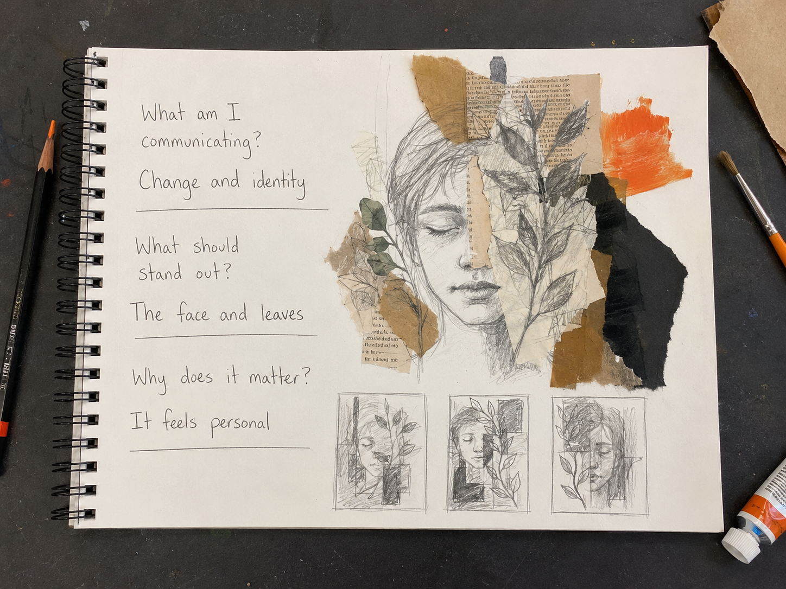
Choose strong
evidence
KEEP
DEVELOP
COMBINE
LEAVE OUT
Move the idea forward.
PORTFOLIO TO A STAR • TEACHER RESOURCE
04
Notes:
Students do not need to include every experiment in the final outcome. Ask them to select, develop, combine or leave out evidence according to the intention. The best choice is the one that moves the idea forward.
[Sources]
- Original Portfolio to A Star teaching material.
- Original AI-generated student-art image created for this resource.

Slide 5
Use influences without copying
OBSERVE
ADAPT
PERSONALISE
what interests you
change the idea
make it yours
Borrow a principle—not an image.
PORTFOLIO TO A STAR • TEACHER RESOURCE
05
Notes:
Ask students to identify a principle from an artist or designer—such as cropping, layering, repetition or colour—then adapt it to their own subject and intention. The goal is influence, not imitation.
[Sources]
- Original Portfolio to A Star teaching material.

Slide 6
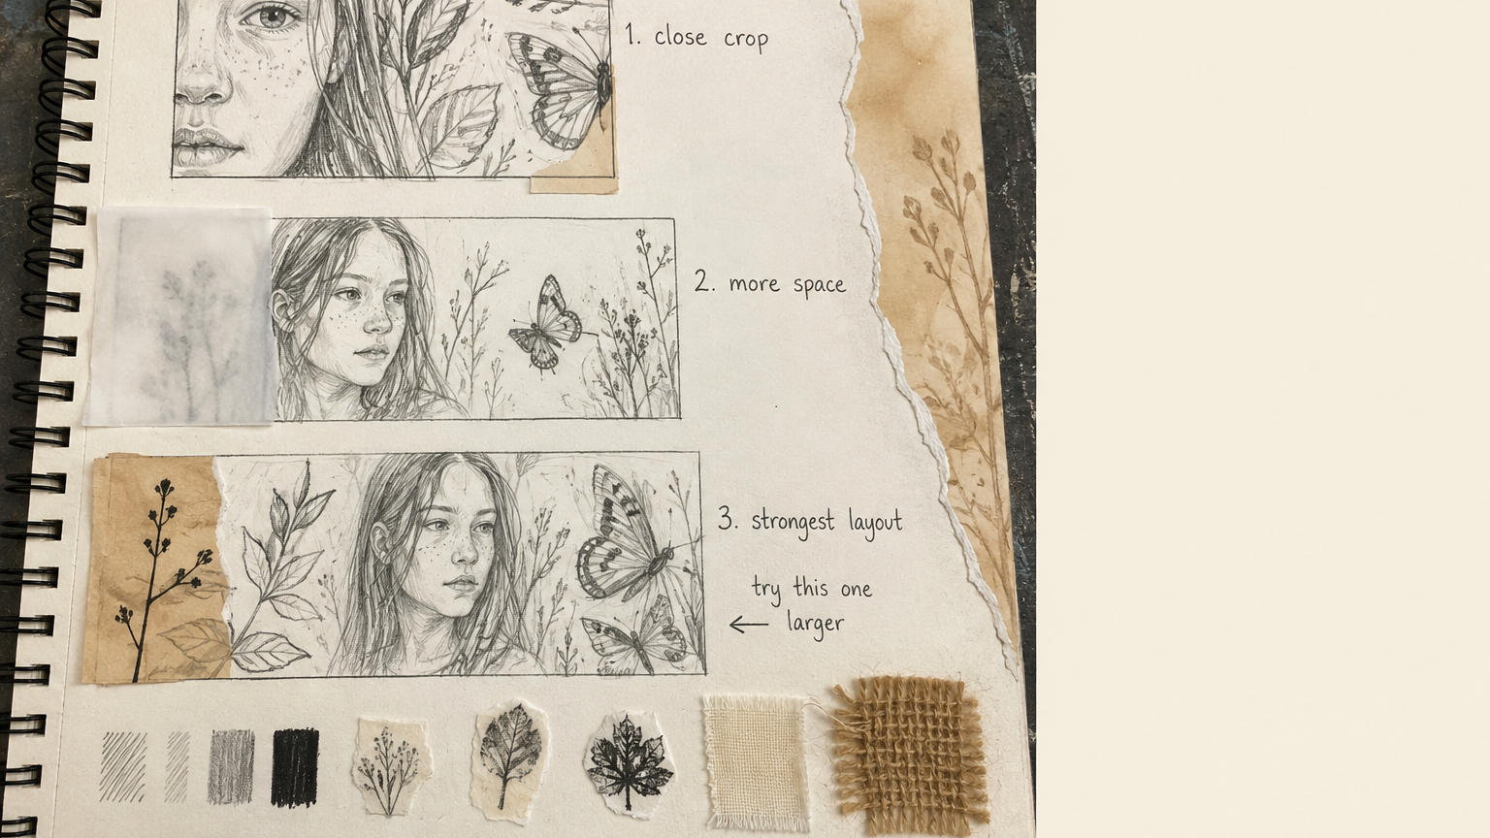
Plan before committing
Composition
Viewpoint
Scale
Try three possibilities.
PORTFOLIO TO A STAR • TEACHER RESOURCE
06
Notes:
Use quick thumbnails to test composition, viewpoint and scale before students invest time in the final piece. Encourage three genuinely different possibilities, then compare them against the intention.
[Sources]
- Original Portfolio to A Star teaching material.
- Original AI-generated student-art image created for this resource.

Slide 7
Test the decisions that matter
I will test
________
because
________
colour • material • scale • layout
PORTFOLIO TO A STAR • TEACHER RESOURCE
07
Notes:
Testing is most useful when one important variable changes at a time. Ask students to state what they will test and why that decision matters to the final outcome.
[Sources]
- Original Portfolio to A Star teaching material.

Slide 8
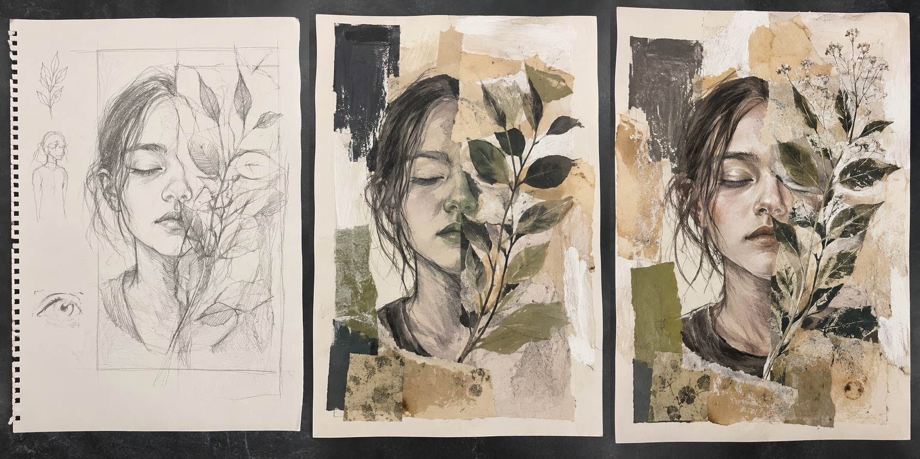
Show how the outcome developed
IDEA
→
TEST
→
REFINE
Notes:
Trace the visual decisions across the three stages. Ask what changed, why it changed and how the later version better supports the intention. Development should be visible rather than merely described.
[Sources]
- Original Portfolio to A Star teaching material.
- Original AI-generated student-art image created for this resource.

Slide 9
Plan the making sequence
PREPARE
→
BUILD
→
REVIEW
→
REFINE
Plan the order before you begin—and leave time to respond.
PORTFOLIO TO A STAR • TEACHER RESOURCE
09
Notes:
Ask students to write a realistic sequence: prepare materials, build the main structure, pause to review and then refine. The review point prevents the plan becoming a rigid checklist.
[Sources]
- Original Portfolio to A Star teaching material.

Slide 10
The final outcome connects every AO
AO1
AO2
AO3
AO4
INFORMS
TESTS
RECORDS
REALISES
The final piece brings the whole creative journey together.
PORTFOLIO TO A STAR • TEACHER RESOURCE
10
Notes:
Connect the outcome back to the whole project. AO1 informs the idea, AO2 tests possibilities, AO3 records decisions and AO4 realises the intention. The final piece should make those connections visible.
[Sources]
- Original Portfolio to A Star teaching material.

Slide 11
Move beyond a vague plan
VAGUE
PURPOSEFUL
“I will make a final piece.”
“I will combine my strongest
portrait, leaf and collage tests.”
Next: test the scale before starting.
PORTFOLIO TO A STAR • TEACHER RESOURCE
11
Notes:
Compare the two plans. The stronger version identifies evidence from the project and names the next test. Ask students which plan would make starting the final piece easier and why.
[Sources]
- Original Portfolio to A Star teaching material.

Slide 12
YOUR TURN
Build your final-outcome plan.
1
INTENTION
Choose one clear next step
and make it achievable.
2
EVIDENCE
3
NEXT TEST
PORTFOLIO TO A STAR • TEACHER RESOURCE
12
Notes:
Give students five minutes to state their intention, select the strongest supporting evidence and name the next practical test. Peer check: is the step specific, realistic and clearly connected to the project?
[Sources]
- Original Portfolio to A Star teaching material.

