Slide 1
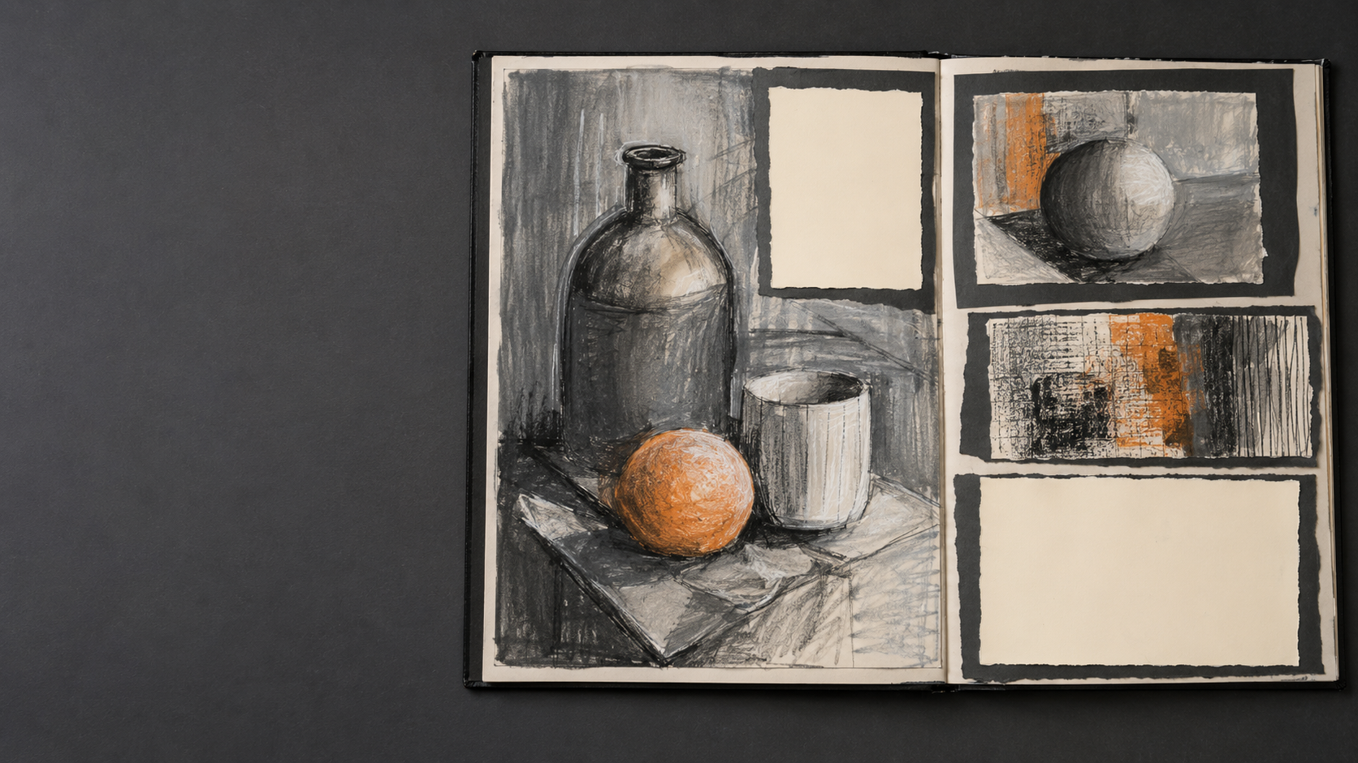
GCSE ART & DESIGN
Improving
Sketchbook
Presentation
A practical guide for GCSE
Art and Design students
PORTFOLIO TO A STAR
Notes:
Introduce presentation as a way to make the creative journey easier to understand. Clarify that a polished-looking page does not replace strong research, experimentation or development; it helps those things read clearly.
[Sources]
- Original AI-generated sketchbook image created for this Portfolio to A Star resource; artwork intentionally modelled at a 14–16-year-old level.

Slide 2
Presentation should make the journey clear
FOCUS
→
ORDER
→
SPACE
Help the viewer know where to look.
PORTFOLIO TO A STAR • TEACHER RESOURCE
02
Notes:
Explain the three priorities: a clear focus, a sensible order and enough space to separate ideas. Presentation supports communication; it should not become a decorative task that consumes more time than the artwork.
[Sources]
- Original Portfolio to A Star teaching material.

Slide 3
Three questions shape every page
WHAT?
WHERE?
NEXT?
What matters
most?
Where should
I look?
What follows
this?
Plan the page before you glue anything down.
PORTFOLIO TO A STAR • TEACHER RESOURCE
03
Notes:
Ask students to answer these questions before mounting work. They should identify the main evidence, decide where the eye should begin and check that the next page or section follows logically.
[Sources]
- Original Portfolio to A Star teaching material.

Slide 4
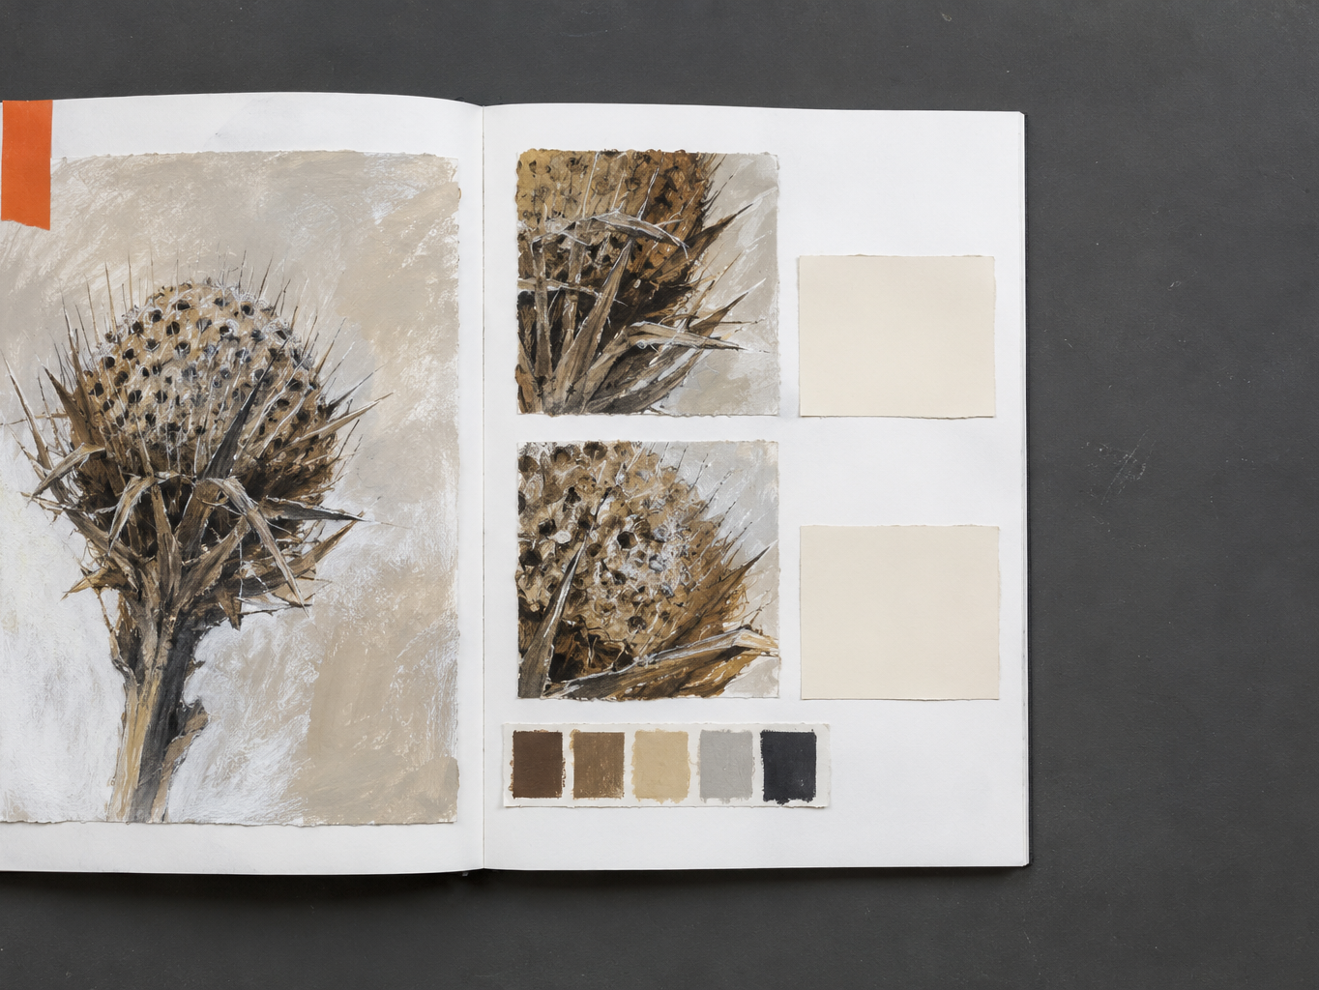
Give each page
one clear focus
Main study
sets the focus.
main image
supporting work
Close-ups add
supporting detail.
annotation
next step
Lead the eye.
PORTFOLIO TO A STAR • TEACHER RESOURCE
04
Notes:
Use the spread to identify the dominant image first. The smaller studies and readable annotations should support that focus rather than compete with it.
[Sources]
- Original AI-generated sketchbook image created for this Portfolio to A Star resource; artwork intentionally modelled at a 14–16-year-old level.

Slide 5
Build a simple visual hierarchy
BIG
→
MEDIUM
→
SMALL
Important work should be noticed first.
PORTFOLIO TO A STAR • TEACHER RESOURCE
05
Notes:
Demonstrate hierarchy with size, placement and contrast. The strongest or most important evidence should receive the most space; supporting studies can be smaller without becoming insignificant.
[Sources]
- Original Portfolio to A Star teaching material.

Slide 6
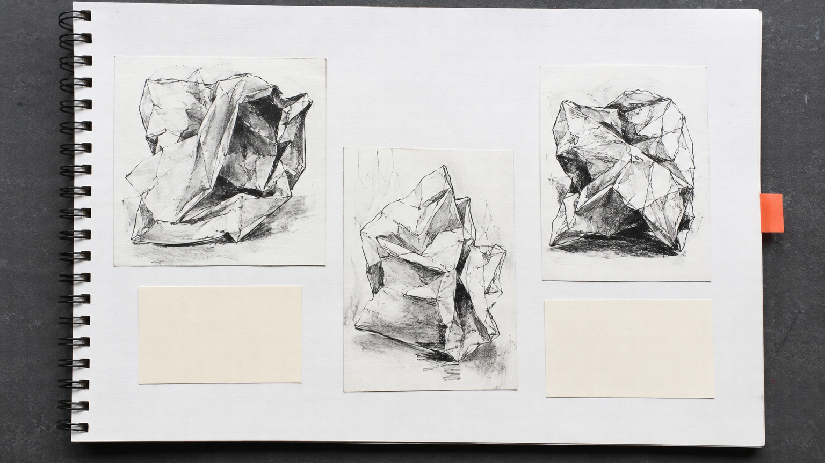
Use space deliberately
Group related work.
Leave breathing room.
Align the edges.
Leaving space keeps
each study separate.
Space creates focus.
PORTFOLIO TO A STAR • TEACHER RESOURCE
06
Notes:
Discuss white space as an active part of the layout. Students should group related evidence, leave separation between ideas and align edges where this improves clarity—without forcing every page into a rigid grid.
[Sources]
- Original AI-generated sketchbook image created for this Portfolio to A Star resource; artwork intentionally modelled at a 14–16-year-old level.

Slide 7
Keep the style consistent
TYPE
COLOUR
MOUNTING
SAME FONT
LIMITED PALETTE
CLEAN EDGES
Let the artwork vary—not the structure.
PORTFOLIO TO A STAR • TEACHER RESOURCE
07
Notes:
Consistency helps the sketchbook feel connected. Suggest one or two type styles, a limited supporting colour palette and broadly consistent mounting. The artwork itself can remain varied and experimental.
[Sources]
- Original Portfolio to A Star teaching material.

Slide 8
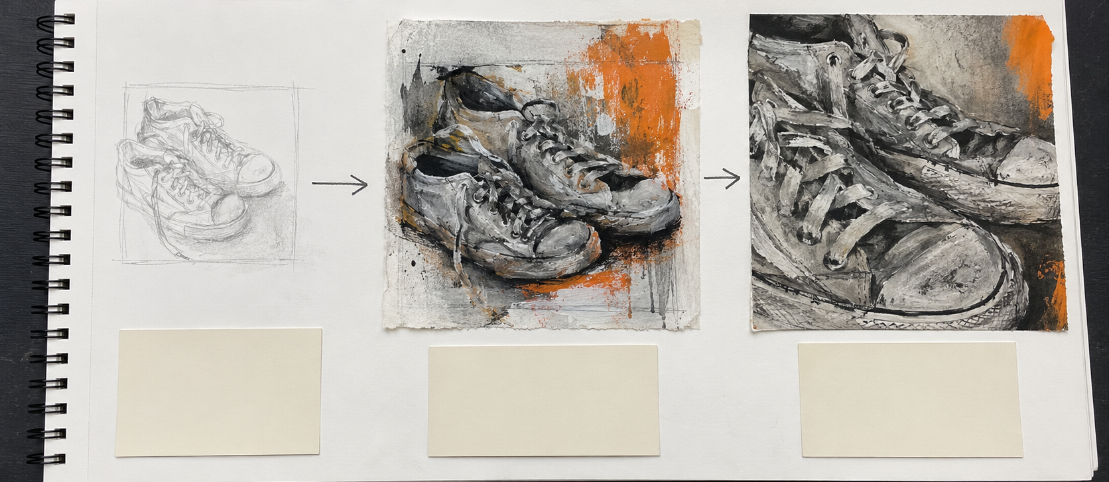
Sequence the creative journey
Initial observation
Test colour + texture
Crop and strengthen
OBSERVE
→
EXPERIMENT
→
REFINE
Notes:
Ask students to arrange evidence so the development can be followed. The sequence does not need to be perfectly chronological, but it should show how observation led to experiments and how those experiments informed refinement.
[Sources]
- Original AI-generated sketchbook image created for this Portfolio to A Star resource; artwork intentionally modelled at a 14–16-year-old level.

Slide 9
Presentation should reveal every AO
AO1
AO2
AO3
AO4
INVESTIGATE
EXPERIMENT
RECORD
REALISE
Make the evidence easy to find—not artificially decorative.
PORTFOLIO TO A STAR • TEACHER RESOURCE
09
Notes:
AQA requires students to select and present work that demonstrates attainment across the assessment objectives, and the portfolio is assessed as a whole. Presentation should make investigation, experimentation, recording and realisation easier to locate; it does not create evidence that is not already present.
[Sources]
- AQA GCSE Art and Design (8201), Scheme of assessment: https://www.aqa.org.uk/subjects/art-and-design/gcse/art-and-design-8201/specification/scheme-of-assessment
- AQA GCSE Art and Design (8201), Skills: https://www.aqa.org.uk/subjects/art-and-design/gcse/art-and-design-8201/specification/subject-content/skills

Slide 10
Avoid presentation that competes with the work
DISTRACTS
SUPPORTS
“Too many colours,
borders and effects.”
“A clear page lets
the work lead.”
The artwork should remain the focus.
PORTFOLIO TO A STAR • TEACHER RESOURCE
10
Notes:
Compare decorative choices with supportive presentation. Repeated borders, excessive backgrounds and too many fonts can draw attention away from evidence. Keep any decoration purposeful and subordinate to the work.
[Sources]
- Original Portfolio to A Star teaching material.

Slide 11
Improve one sketchbook spread
SELECT
→
GROUP
→
ALIGN
→
EDIT
Remove anything that does not add evidence.
Use the space to make the strongest work clear.
PORTFOLIO TO A STAR • TEACHER RESOURCE
11
Notes:
Model the four-step method on a real spread: select the strongest evidence, group related items, align where useful and edit unnecessary repetition or decoration. Do not remove evidence simply to make a page look sparse.
[Sources]
- Original Portfolio to A Star teaching material.

Slide 12
YOUR TURN
Choose one sketchbook spread.
1
FOCUS
Make the page guide
the viewer.
2
ORDER
3
SPACE
PORTFOLIO TO A STAR • TEACHER RESOURCE
12
Notes:
Give students five to ten minutes to review one spread. They should identify the focus, check the order and decide whether spacing helps or hinders clarity. Peer check: can another student tell what matters first and what development follows?
[Sources]
- Original Portfolio to A Star teaching material.

