Slide 1
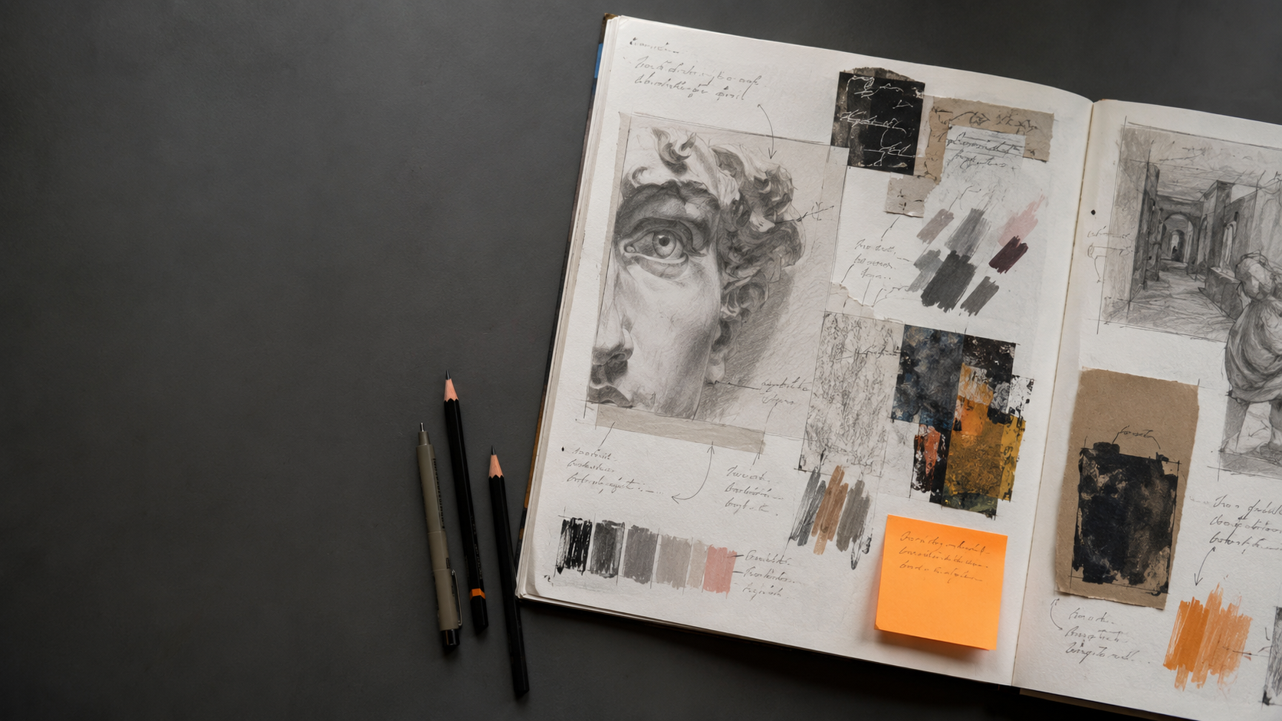
How to Annotate Art and Design Work Effectively
A practical guide for GCSE
Art and Design students
PORTFOLIO TO A STAR
Notes:
Introduce annotation as a record of creative thinking—not an essay. Tell students that the slides will give them a repeatable way to explain decisions without writing large amounts.
[Sources]
- Original AI-generated sketchbook image created for this Portfolio to A Star resource.

Slide 2
Annotation makes your thinking visible
NOTICE
→
EXPLAIN
→
DECIDE
Show how your work moves forward.
PORTFOLIO TO A STAR • TEACHER RESOURCE
02
Notes:
Explain the three jobs of annotation. Students notice what happened, explain why it matters, and decide what to do next. Good annotation follows the work rather than sitting beside it as decoration.
[Sources]
- Original Portfolio to A Star teaching material.

Slide 3
Three questions unlock a useful annotation
WHAT?
WHY?
NEXT?
What did I do?
Why this choice?
What will I change?
Three short answers are often enough.
PORTFOLIO TO A STAR • TEACHER RESOURCE
03
Notes:
Model the three questions aloud using a recent classroom experiment. Encourage students to answer each question in one clear phrase before combining the phrases into an annotation.
[Sources]
- Original Portfolio to A Star teaching material.

Slide 4
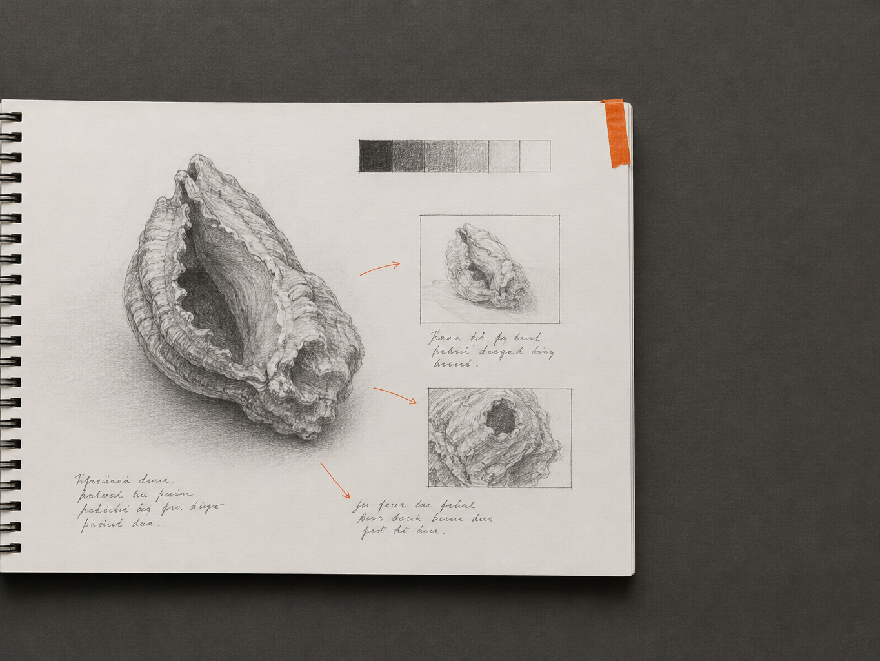
Start with what
you can see
line
tone
texture
shape
Be specific.
PORTFOLIO TO A STAR • TEACHER RESOURCE
04
Notes:
Ask students to identify one visible quality before explaining it. Replace vague words such as ‘nice’ or ‘good’ with subject vocabulary: line, tone, texture, shape, colour, form, contrast or composition.
[Sources]
- Original AI-generated sketchbook image created for this Portfolio to A Star resource.

Slide 5
Then explain your choice
I chose
________
because
________
material • technique • composition
PORTFOLIO TO A STAR • TEACHER RESOURCE
05
Notes:
The word ‘because’ forces a reason. Invite students to name the material, technique or compositional choice and connect it to their intention. One purposeful sentence is better than a long description.
[Sources]
- Original Portfolio to A Star teaching material.

Slide 6
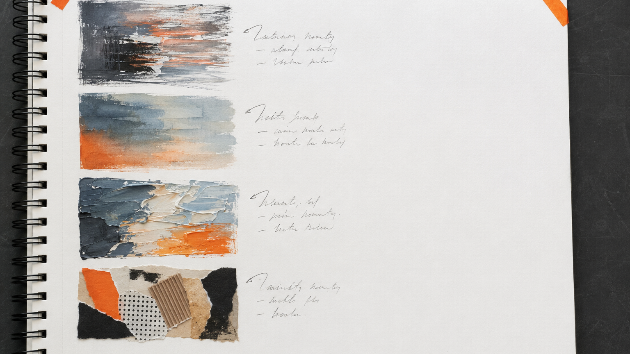
Review the experiment
It worked because…
I would change…
Next, I will…
Evaluate the work—not yourself.
PORTFOLIO TO A STAR • TEACHER RESOURCE
06
Notes:
Keep evaluation focused on the visual result. Instead of ‘I am bad at paint’, students should identify what happened in the paint test and name a specific adjustment for the next attempt.
[Sources]
- Original AI-generated sketchbook image created for this Portfolio to A Star resource.

Slide 7
Connect an influence to your own work
I noticed…
I tried…
I changed…
OBSERVE
TEST
PERSONALISE
Not a biography.
PORTFOLIO TO A STAR • TEACHER RESOURCE
07
Notes:
Artist research should influence practical decisions. Ask students to name one feature they noticed, one thing they tested, and one way they changed it to suit their own idea. Avoid copying a biography into the sketchbook.
[Sources]
- Original Portfolio to A Star teaching material.

Slide 8
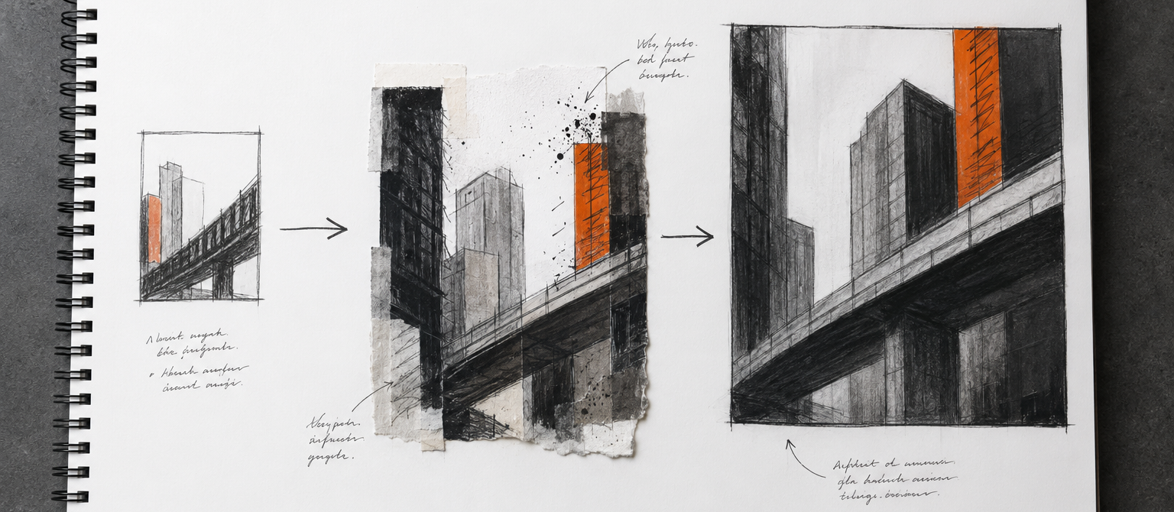
Show how the idea developed
→
→
IDEA
TEST
REFINE
Notes:
Use the image to trace a decision through three stages. Annotation should help a viewer understand what changed between stages and why the later version is closer to the student’s intention.
[Sources]
- Original AI-generated sketchbook image created for this Portfolio to A Star resource.

Slide 9
Annotation can support every AO
AO1
AO2
AO3
AO4
INVESTIGATE
EXPERIMENT
RECORD
REALISE
Written annotation is evidenced in AO3—and can support the others.
PORTFOLIO TO A STAR • TEACHER RESOURCE
09
Notes:
Clarify that annotation is not a separate assessment objective and written quantity is not the goal. AQA states that written annotation must be evidenced in AO3 and can also contribute to AO1, AO2 and AO4. Use annotation to reveal investigation, refinement, recording and realisation.
[Sources]
- AQA GCSE Art and Design (8201), Scheme of assessment: https://www.aqa.org.uk/subjects/art-and-design/gcse/art-and-design-8201/specification/scheme-of-assessment
- AQA GCSE Art and Design (8201), Skills: https://www.aqa.org.uk/subjects/art-and-design/gcse/art-and-design-8201/specification/subject-content/skills

Slide 10
Move beyond labels
STOPS HERE
MOVES FORWARD
“I used pencil.”
“Soft pencil helped me
build gradual tone.”
Next: deepen the darkest shadows.
PORTFOLIO TO A STAR • TEACHER RESOURCE
10
Notes:
Compare the two examples. Both are short, but the second identifies an effect and gives a specific next step. Ask students which version helps a teacher or moderator understand the creative decision.
[Sources]
- Original Portfolio to A Star teaching material.

Slide 11
Build one strong annotation
CHOICE
→
REASON
→
EFFECT
→
NEXT STEP
I used _______________ because ________________ ; this created ___________,
so next I will ____________________________________________________________.
PORTFOLIO TO A STAR • TEACHER RESOURCE
11
Notes:
Use the four-part formula as a scaffold, not a rule. Students can remove it once they can write independently. Ask them to keep the sequence focused on a real piece of work in front of them.
[Sources]
- Original Portfolio to A Star teaching material.

Slide 12
YOUR TURN
Choose one experiment.
1
CHOICE
Make every annotation
move the work forward.
2
EFFECT
3
NEXT STEP
PORTFOLIO TO A STAR • TEACHER RESOURCE
12
Notes:
Give students five minutes to annotate one experiment using choice, effect and next step. Peer check: can a partner identify the decision, the visual evidence and the planned improvement? Close by reminding students that useful annotation moves the project forward.
[Sources]
- Original Portfolio to A Star teaching material.

